Slide 1
Right To Information Act 2005
Module 2

Slide 2
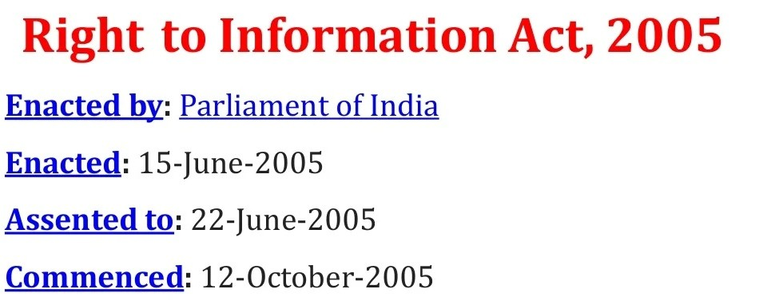

Slide 3
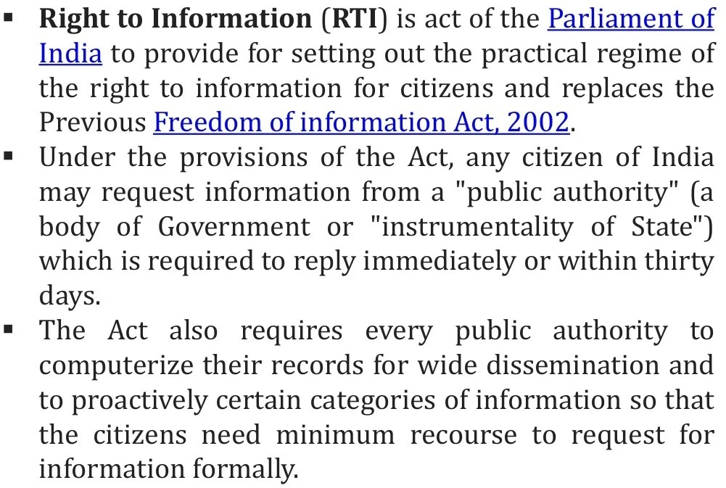

Slide 4
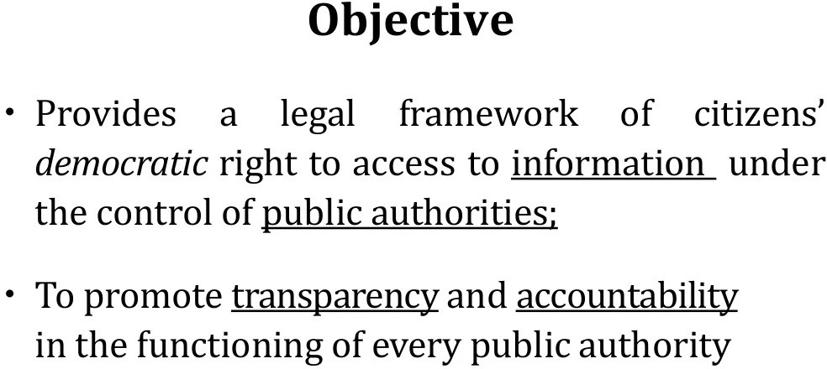

Slide 5
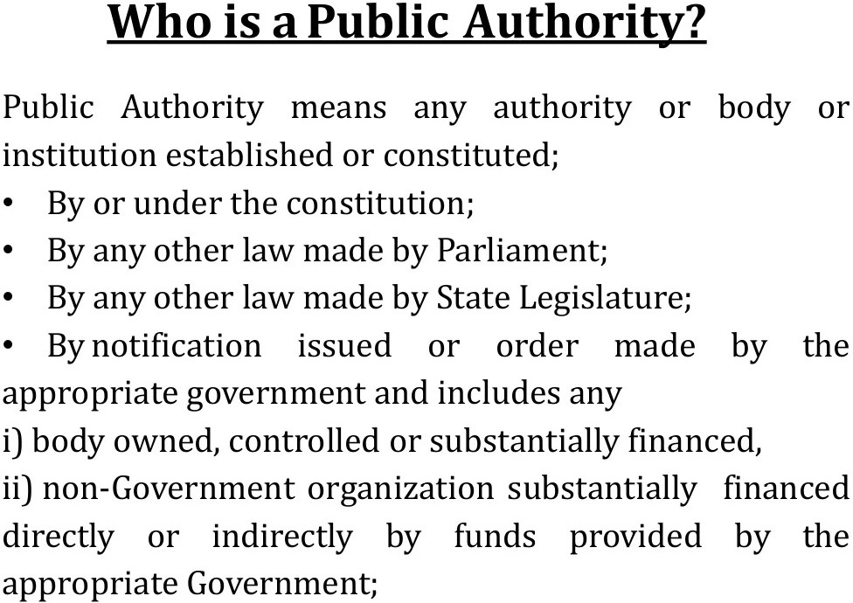

Slide 6
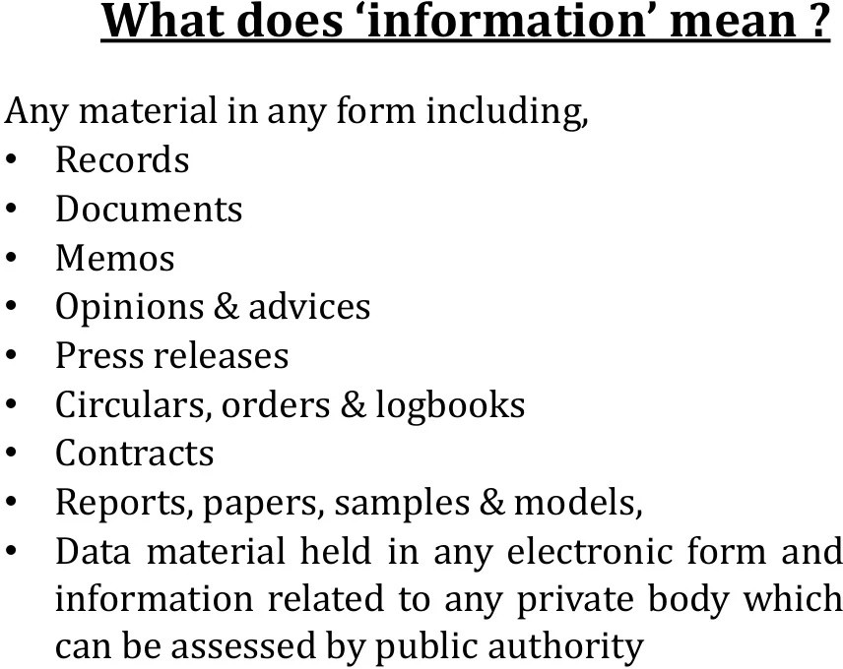

Slide 7
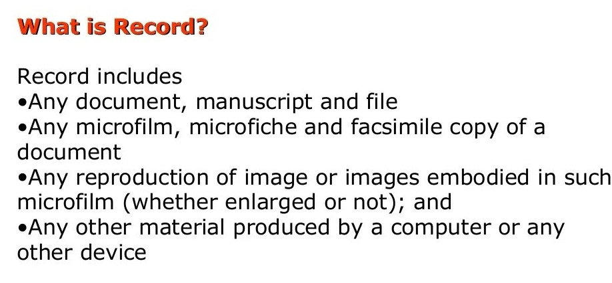

Slide 8
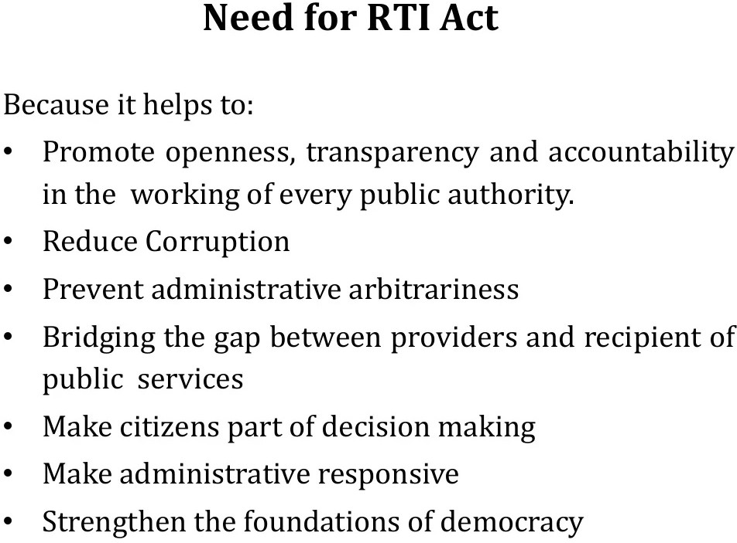

Slide 9
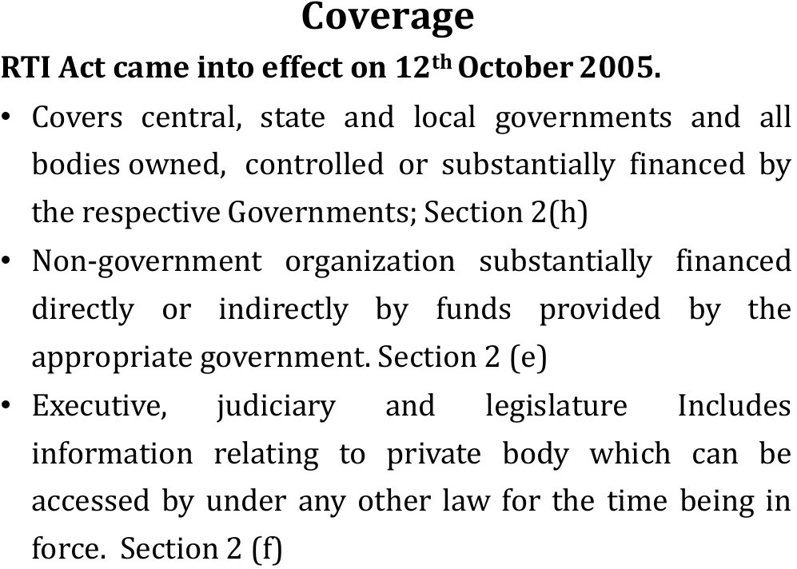

Slide 10
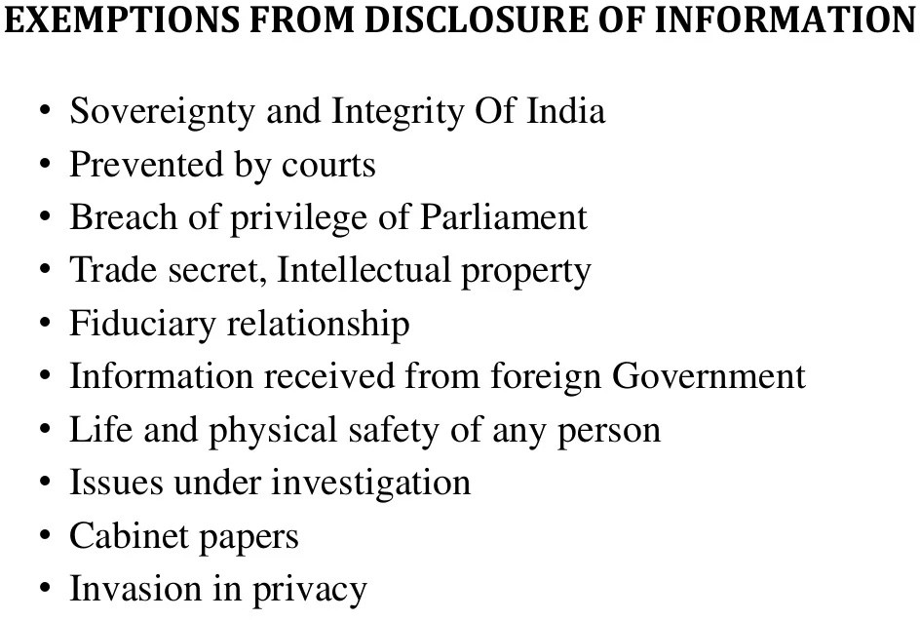

Slide 11
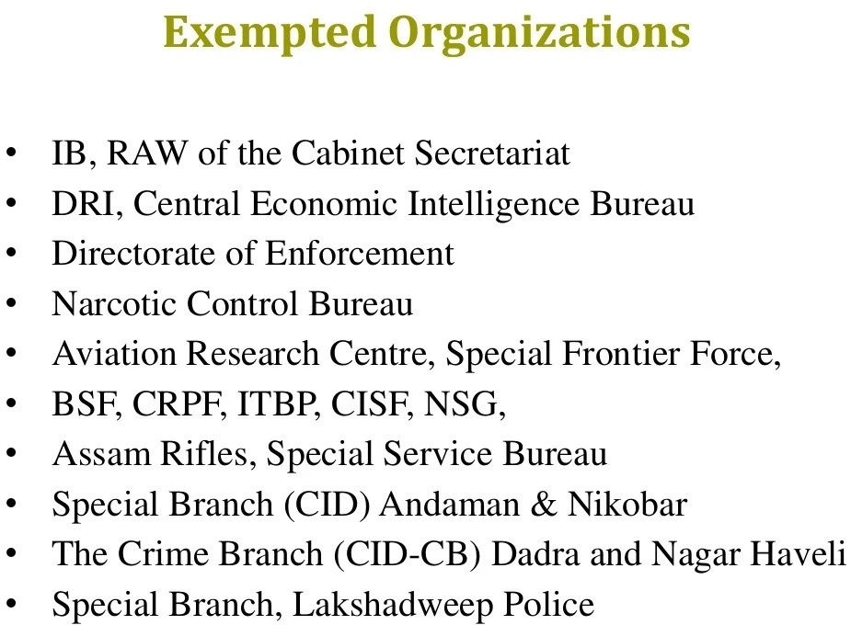
Notes:
Intelligence Bureau.
2. Research and Analysis Wing of the Cabinet Secretariat.
3. Directorate of Revenue Intelligence.
4. Central Economic Intelligence Bureau.
5. Directorate of Enforcement.
6. Narcotics Control Bureau.
7.
Aviation Research Centre.
8. Special Frontier Force.
9. Border Security Force.
10. Central Reserve Police Force.
11. Indo-Tibetan Border Police.
12. Central Industrial Security Force.
13. National Security Guards.
14. Assam Rifles.
15. Special Service Bureau.
16.
Special Branch (CID), Andaman and Nicobar.
17. The Crime Branch-C.I.D.- CB, Dadra and Nagar Haveli.
18. Special Branch, Lakshadweep Police.

Slide 12
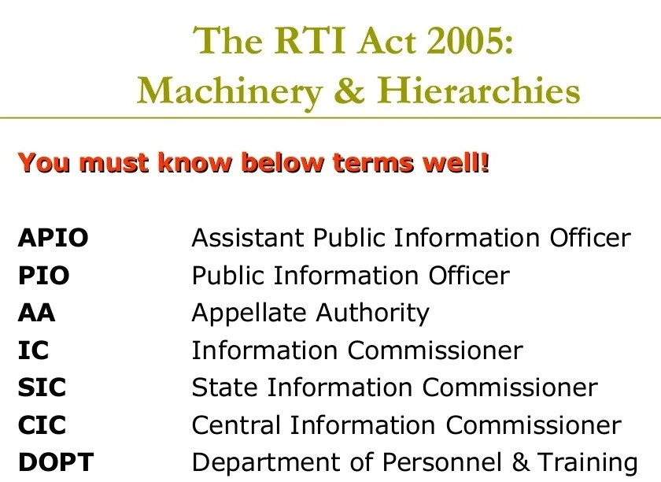

Slide 13
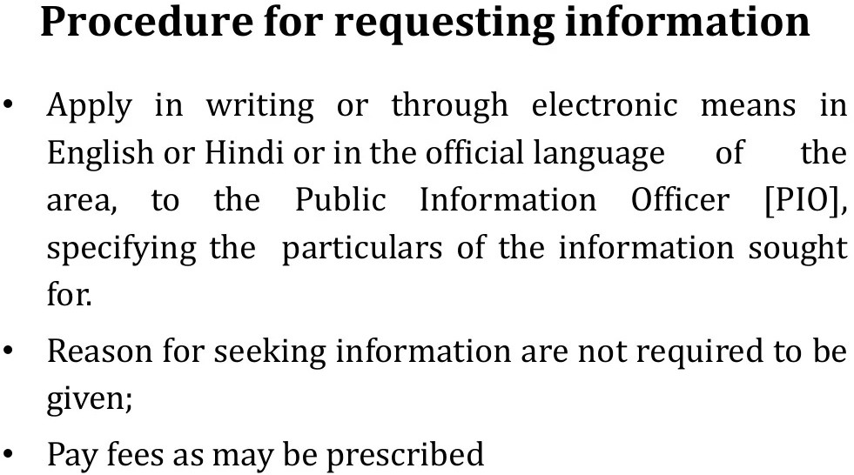

Slide 14
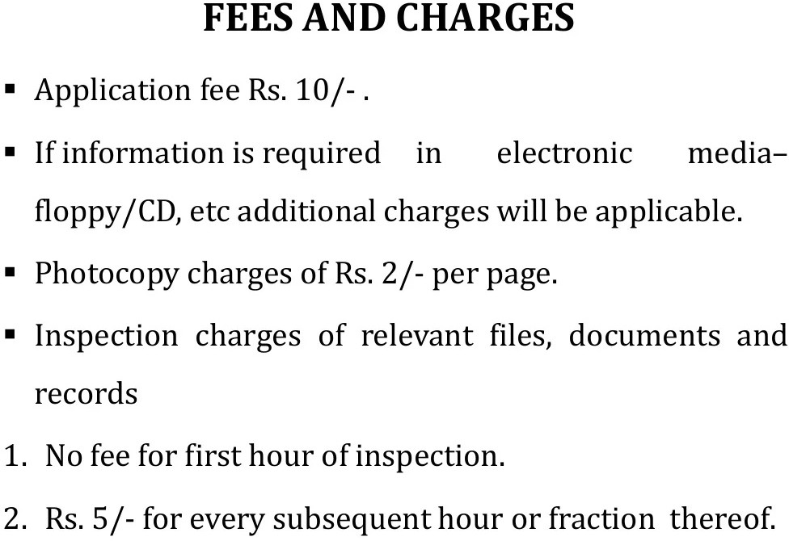

Slide 15
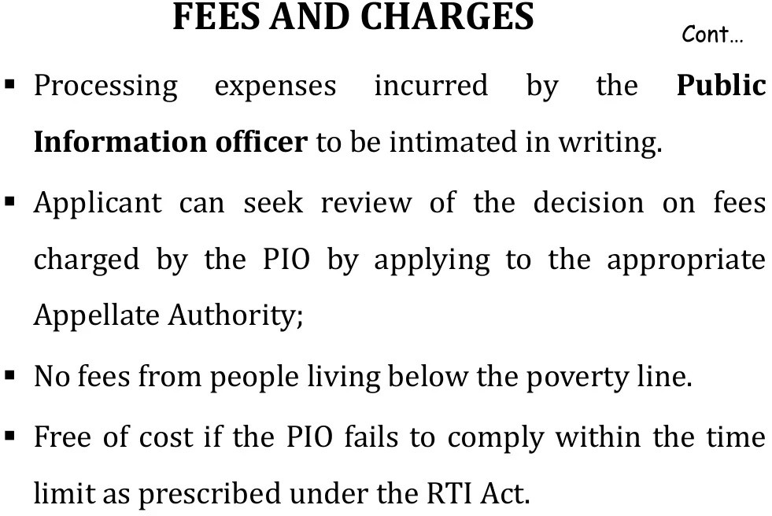

Slide 16
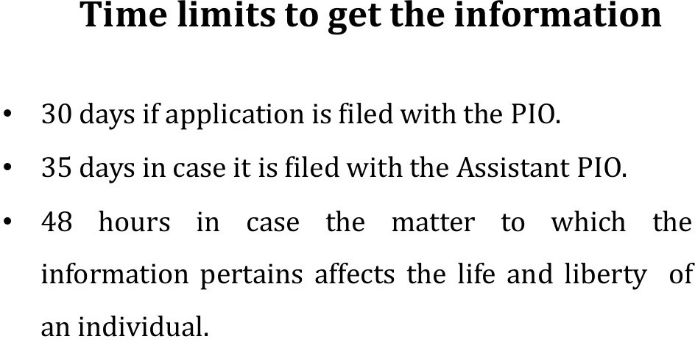

Slide 17


Slide 18
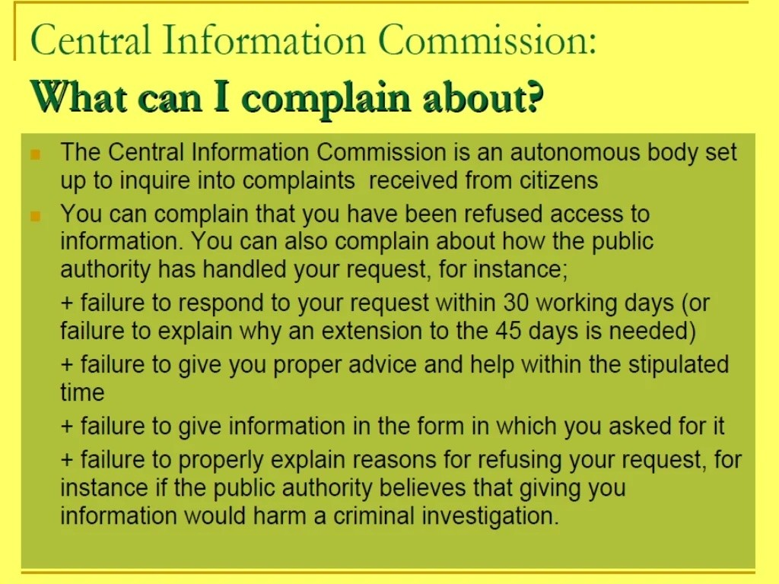

Slide 19
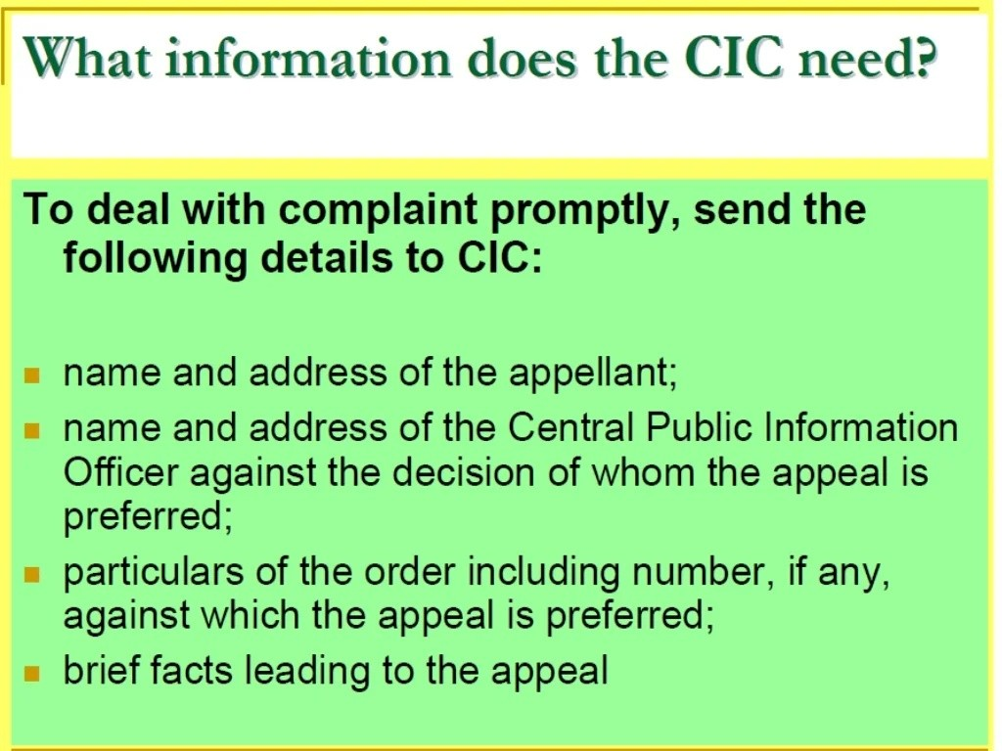

Slide 20
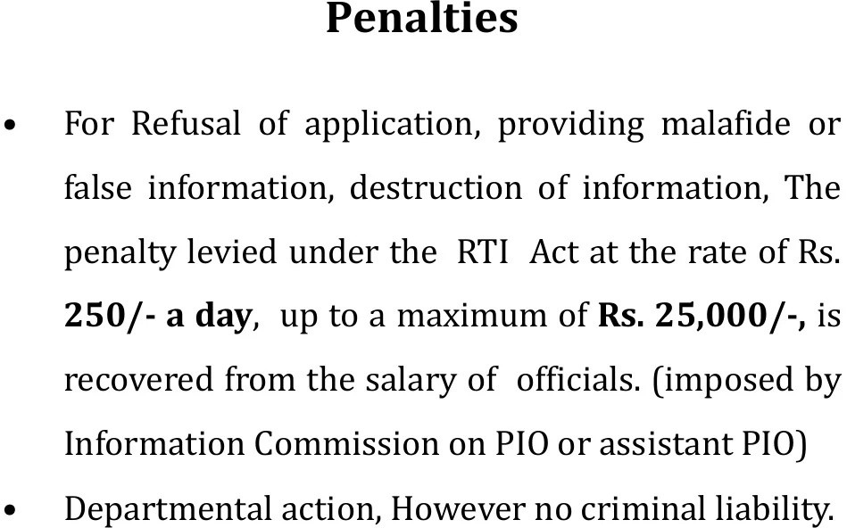

Slide 21
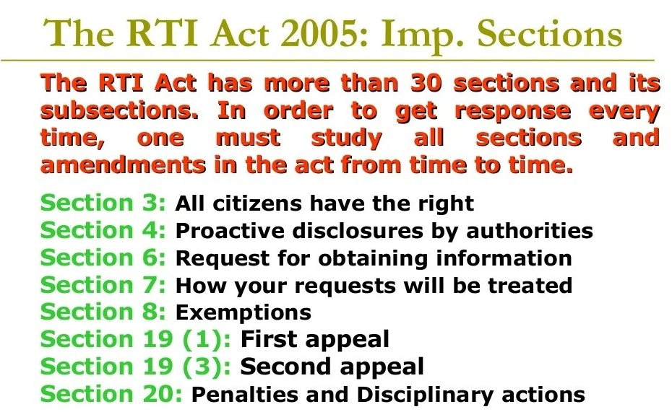

Slide 22
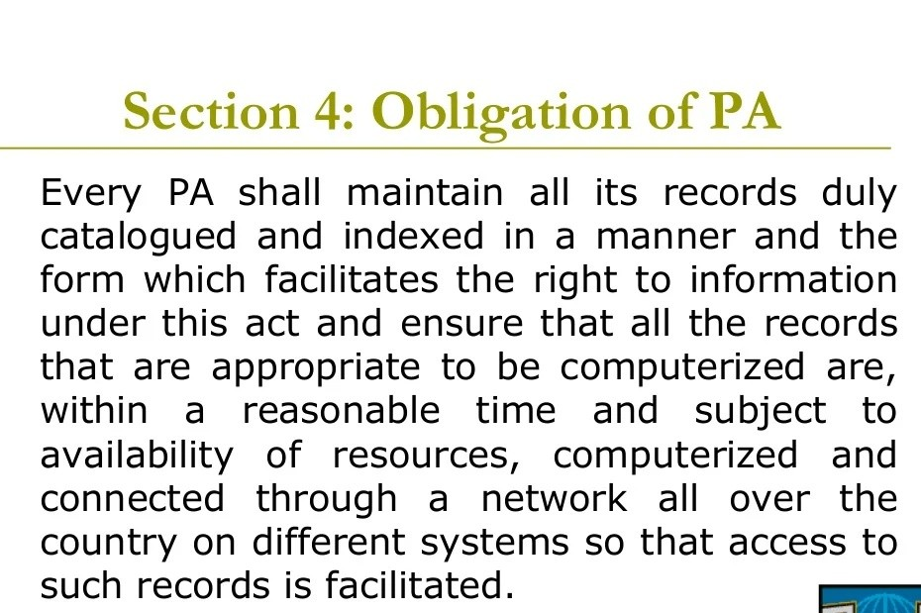

Slide 23
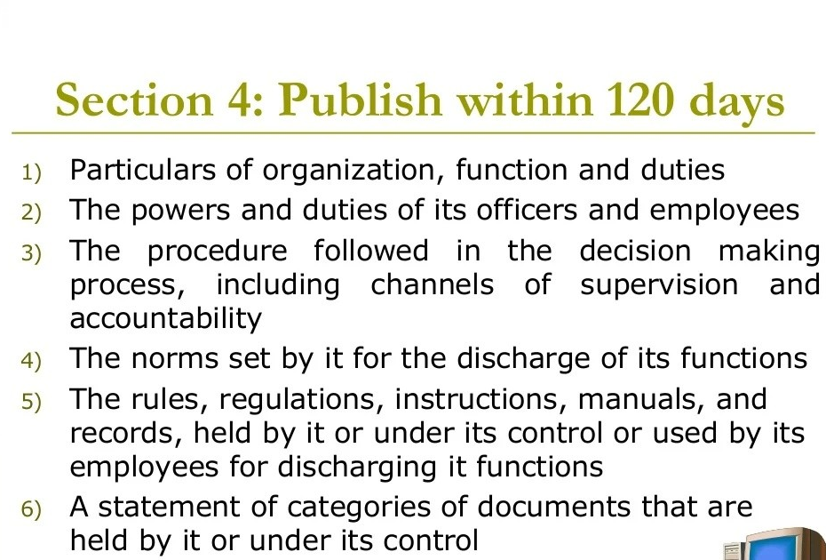

Slide 24
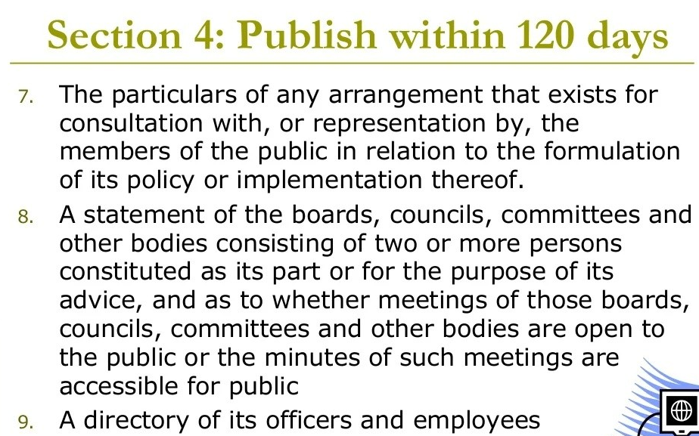

Slide 25
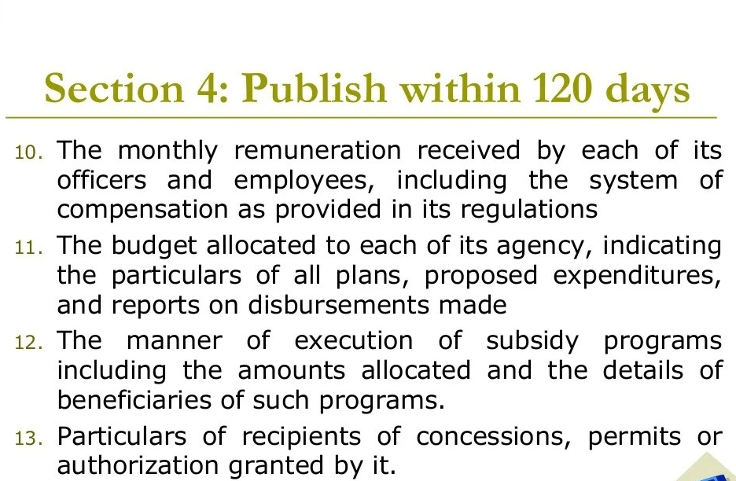

Slide 26
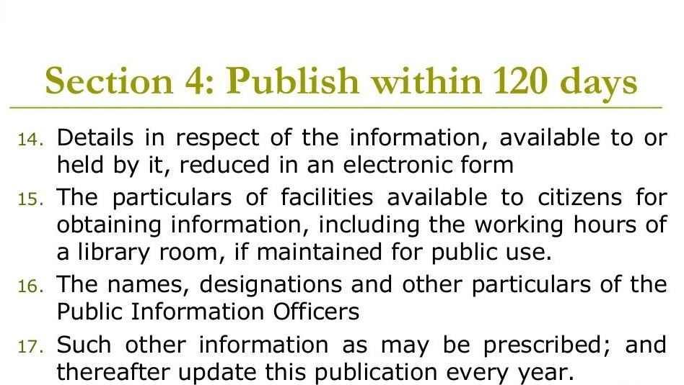

Slide 27
Thank You

